Slide 1
Digital Services Contracting Professional Development MVP Program Orientation
August 2016

Slide 2
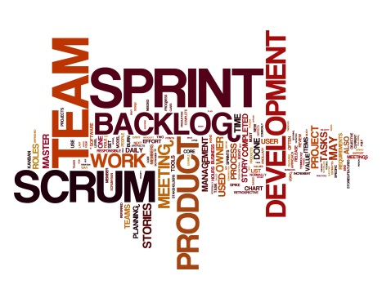




Understanding the Digital Acquisition Need
Changing Consumer Demand
Digital Industry
Characterized by:
High ability to interact with digital
Responsiveness of company/org to “my needs”
Characterized by:
Rapid pace of development
Iterative process
Fast stand-up/ stand-down of innovations
Government Budget Pressure
Characterized by:
Need for technology and automation to increase service and decrease cost
BUDGET

Slide 3
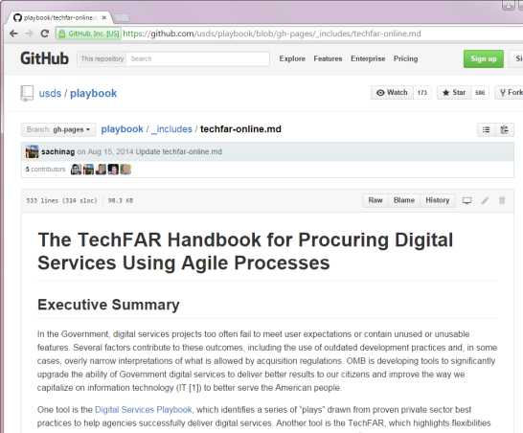

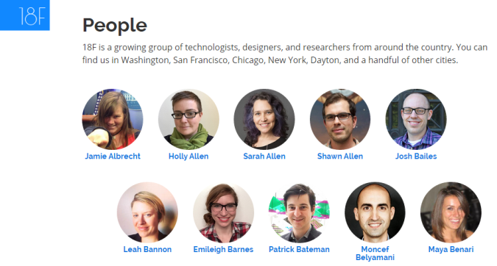
Digital Acquisition Across Government
Policy
Collaborative Groups
TechFAR
Digital Services Playbook
TechFAR Hub (https://techfarhub.cio.gov/)
U.S. Digital Service and 18F
Acquisition Innovation Lab
Recruitment and Hiring
Bringing forward-thinking technologists into government

Slide 4
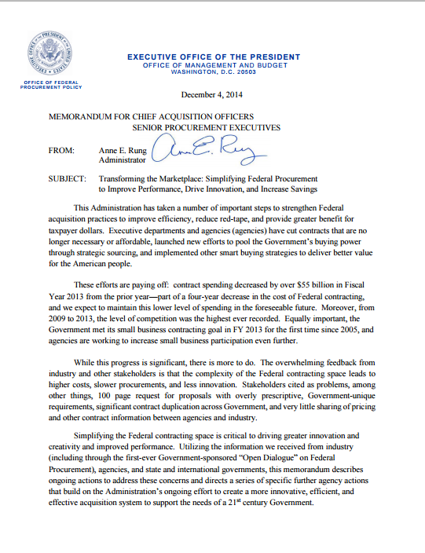
OFPP Administrator Rung’s Memoranda
December 4, 2014
“The U.S. Digital Services, in partnership with OFPP, will pilot a program to train agency personnel in digital IT acquisitions and deploy trained personnel so as to encourage innovative acquisition practices Government-wide.”

Slide 5
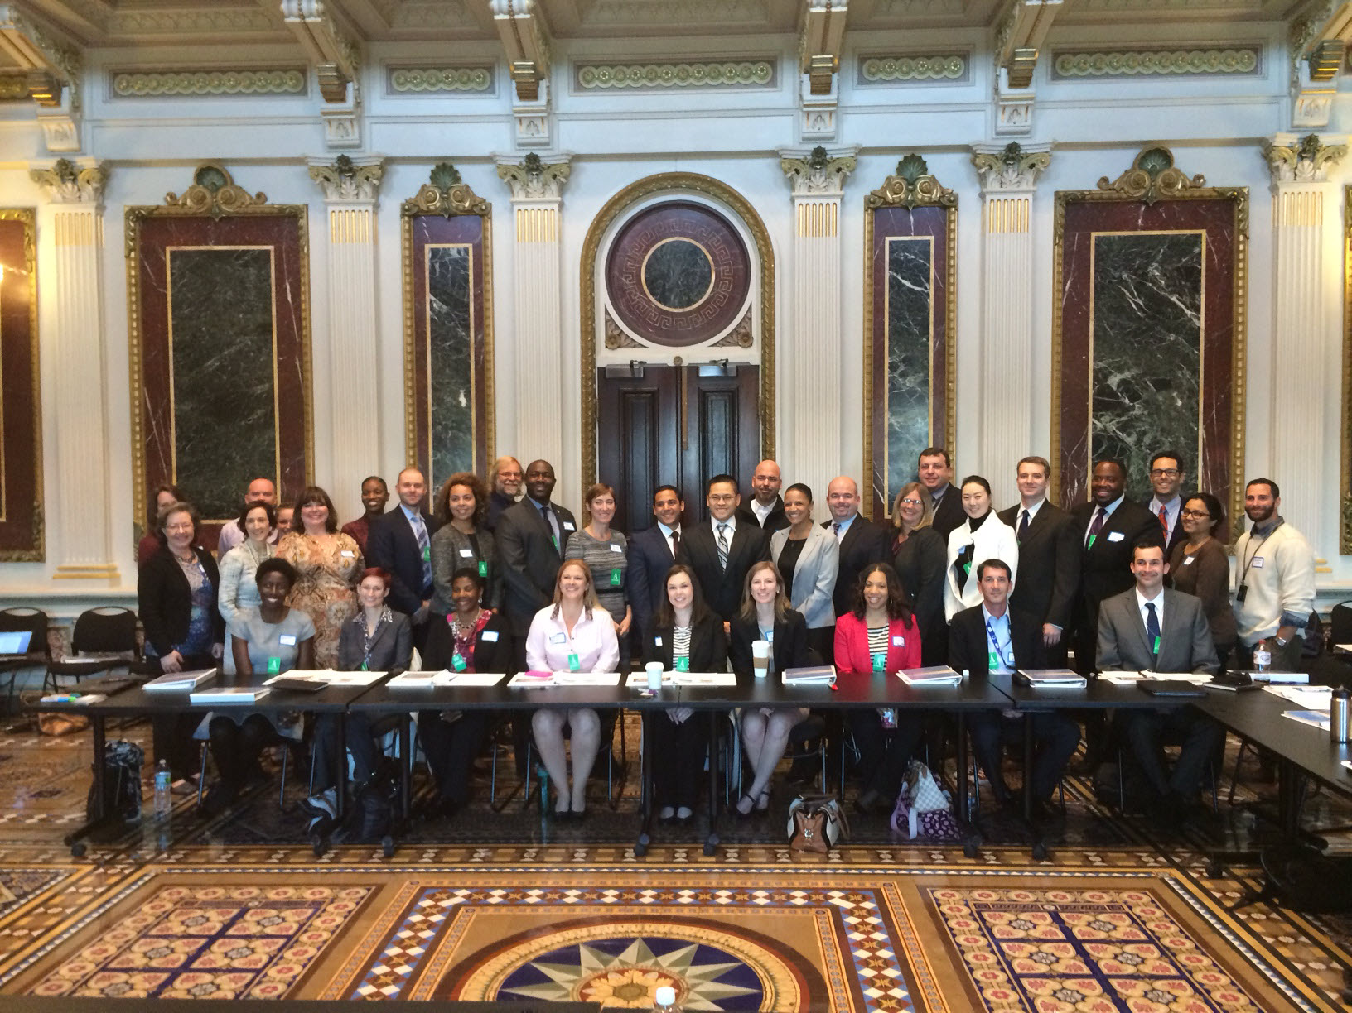
Digital Acquisition Pilot

Slide 6
Program Goals
By the end of this program, you should be able to:
Effectively procure digital services and supplies utilizing concepts such as those described in the Digital Services Playbook and TechFAR; appropriately measure the success of these contracts; accurately describe and define the value received, encourage the use of commercial practices and innovative, flexible approaches; and describe how to effectively make contributions to digital services procurement processes.
Serve as a business advisor within agency Digital Service teams, providing strategic support to the team, its customers, and its stakeholders.
Lead agency training, workshops, and consultations in order to expand digital service procurement expertise within your agency and the government.

Slide 7
Digital Services Contracting Professional Development Program
Pre-Assessment and Orientation
Release 1
Digital Services in the 21st Century Government
Iteration 1.A: The Digital Services Professional (approximately August 8 – 19)
Release 2
What Are You Buying?
Iteration 2.A: Understanding Your Needs and Agency Readiness (approximately September 6 – October 7)
Release 3
Release 4
How Do You Buy?
Iteration 3.A: Developing an Acquisition Strategy (approximately October 24 – November 4)
Iteration 4.A: Awarding Digital Service Contracts (approximately November 28 – December 8)
Awarding & Administering Digital Service Contracts
Iteration 1.B: The Digital Services World (approximately August 22 – September 2)
Iteration 2.B: The Digital Services Market (approximately October 11 – October 21)
Iteration 3.B: Acquiring Digital Services (approximately November 7 – November 22)
Iteration 4.B: Digital Services Delivery (approximately December 12 – December 21)
Capstone: January 9-11

Slide 8
Orientation Agenda
Day 1 – The Need and Role for Digital Acquisition Professionals in Government
Day 2 – Digital Services and Agile Introduction
Day 3 – Acquiring Digital Services
Morning | Digital Services Playbook Digital Services Overview Agile Overview
LUNCH
Afternoon | Scrum Framework Release Planning Sprint Planning, Implementation, Review, and Retrospective
Morning | Day 2 Review/Pre-Program Survey Results Implementing Agile in Government SBA Case Study
LUNCH
Afternoon | SBA (or other) Panel Discussion TechFAR Hub Group Work Orientation Review
Morning | Program Overview Guest Speakers
LUNCH
Afternoon | Design Overview DiSC assessment debrief/activity Live Digital Assignment Networking Event

Slide 9
Activity: Introductions

Slide 10
Introductions
Name
Home agency
Length in current role
Digital acquisition experience, if relevant
Something that made you interested in the program (you can use your interest statement to guide your introduction)

Slide 11
Program Overview

Slide 12
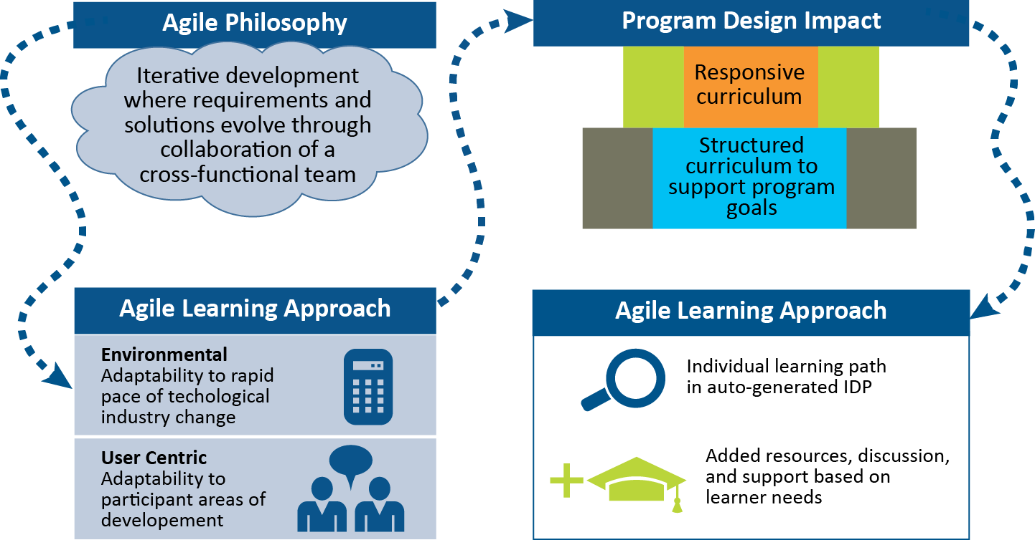
Agile Learning Design
Agile Philosophy
Iterative development where requirements and solutions evolve through collaboration of a cross-functional team
Resulting Program Design
Environment
Adaptability to rapid pace
of technological industry
change

Slide 13
Digital Services Contracting Professional Development Program
Pre-Assessment and Orientation
Release 1
Digital Services in the 21st Century Government
Iteration 1.A: The Digital Services Professional (approximately August 8 – 19)
Release 2
What Are You Buying?
Iteration 2.A: Understanding Your Needs and Agency Readiness (approximately September 6 – October 7)
Release 3
Release 4
How Do You Buy?
Iteration 3.A: Developing an Acquisition Strategy (approximately October 24 – November 4)
Iteration 4.A: Awarding Digital Service Contracts (approximately November 28 – December 8)
Awarding & Administering Digital Service Contracts
Iteration 1.B: The Digital Services World (approximately August 22 – September 2)
Iteration 2.B: The Digital Services Market (approximately October 11 – October 21)
Iteration 3.B: Acquiring Digital Services (approximately November 7 – November 22)
Iteration 4.B: Digital Services Delivery (approximately December 12 – December 21)
Capstone: January 9-11

Slide 14
Program Grading
Participation:
Completing self-directed learning
Completing readings
Posting to blog/discussion board
Attending live virtual and in-person meetings
Capstone Skills Assessment:
Obtaining a passing score
Live Digital Assignment:
Average of: self-review, peer rating, and panel rating

Slide 15
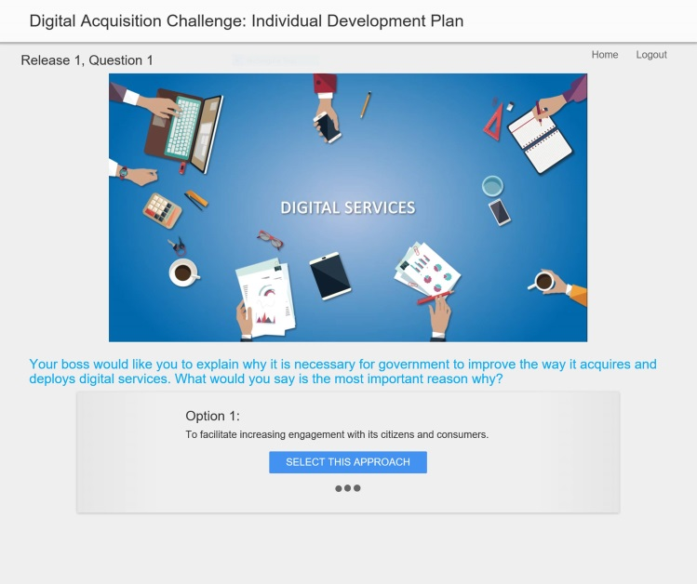
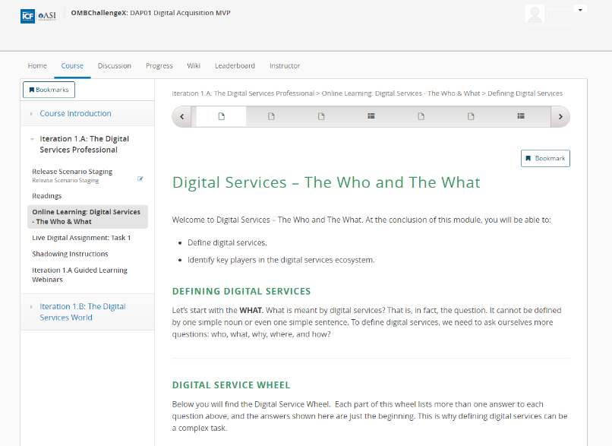
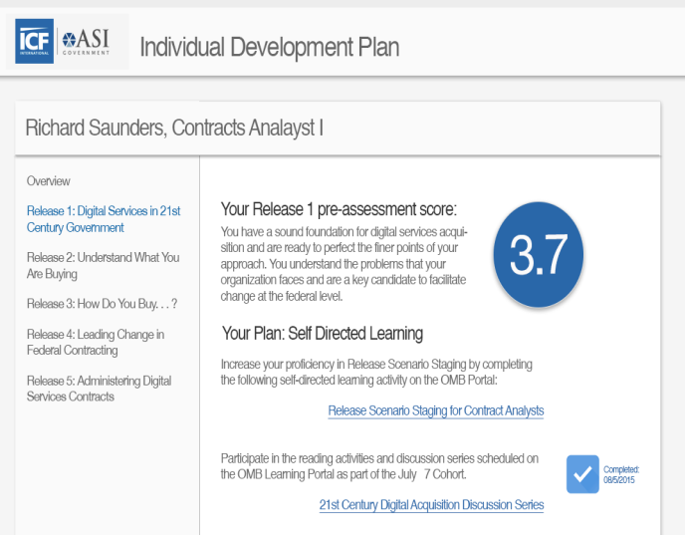

Navigating the Program
Take pre-assessment
Participate in sessions and activities
Practice and contribute
Receive customized IDP

Slide 16
Navigating the Program
✓
Take pre-assessment
Participate in sessions and activities
✓
Practice and contribute
Receive customized IDP

Slide 17
Release Rhythm – What You Need To Do
Iteration X.A
Iteration X.B
Week 1
Week 2
Week 3
Week 4
Iteration Planning
30-minute webinar
Iteration Retrospective
60-minute webinar
Iteration Planning
30-minute webinar
Classroom Learning
4 days in-person
Release Scenario Staging
30-minute assessment
Office Hours
60-minute webinar
Office Hours
60-minute webinar
Self-Directed Learning
~2-3 hours of online learning, reading, and videos
Self-Directed Learning
~2-3 hours of online learning, reading, and videos
Discussion Board and/or Blog Responses
~30 minutes of posting
Discussion Board and/or Blog Responses
~30 minutes of posting
Case Studies and Threaded Scenarios
30 minutes of activity completion
Case Studies and Threaded Scenarios
30 minutes of activity completion
Live Digital Assignment
Team meetings and working on assignments
Shadowing
Ongoing activity

Slide 18
Morning Break

Slide 19
Guest Speakers

Slide 20
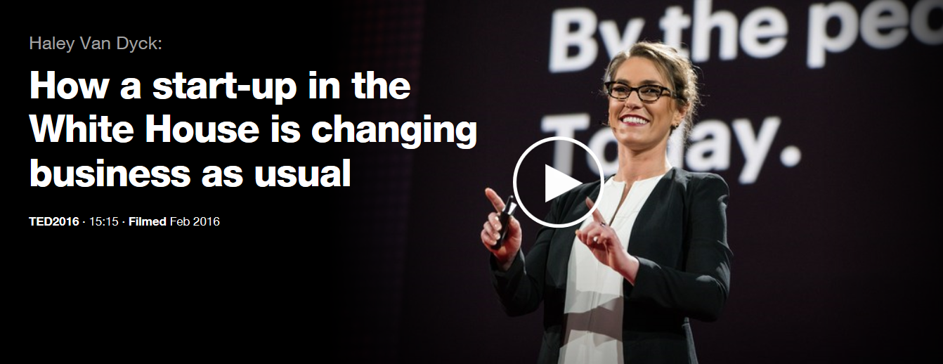
TED Talk with Haley Van Dyck

Slide 21
Guest Speaker: Mikey Dickerson (or other digital services leader)
“Mastering technology is one of the greatest challenges facing our government, and our generation is answering the call.”
“We are partnering with dedicated public servants to… gain traction on mission critical problems that have the most impact on everyday people.”
“I am reminded of a quote by President Kennedy that is sewn into the Oval Office rug: ‘No problem of human destiny is beyond human beings.’”

Slide 22
Program Overview, continued

Slide 23
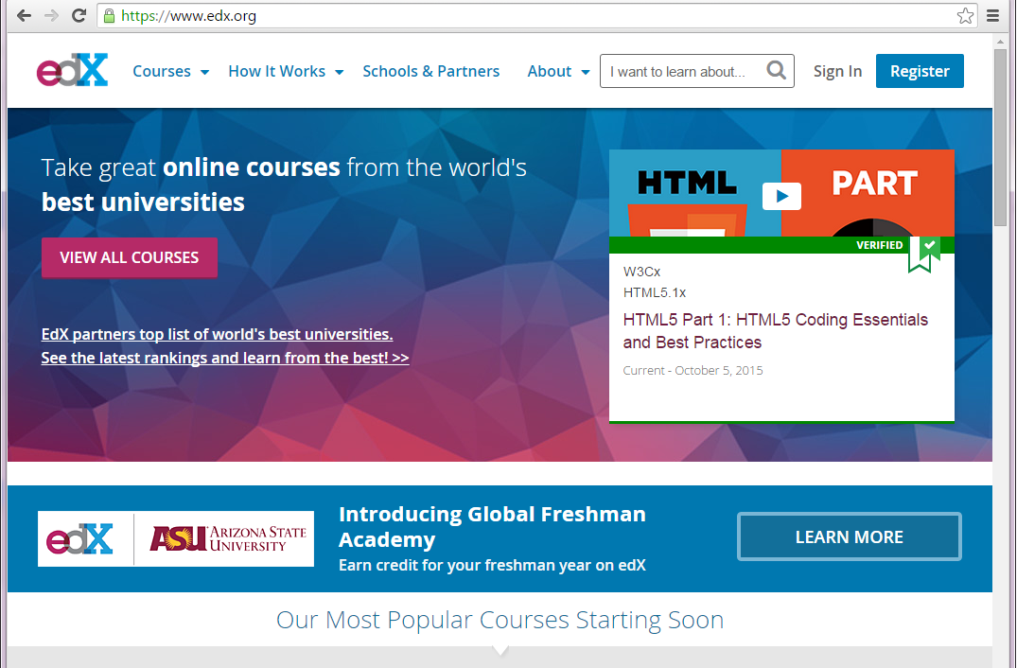
Welcome to edX
edX was founded as a collaborative online, open source learning provider in 2012 in a Harvard-MIT partnership
It offers free online courses in a wide range of disciplines around the world
edX also offers its platform to businesses to host their learning programs
Think of it as a “one stop shop” to access all learning and development opportunities associated with this pilot – on any device!

Slide 24
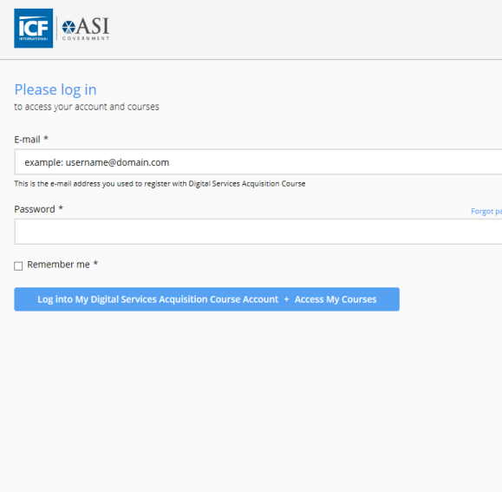
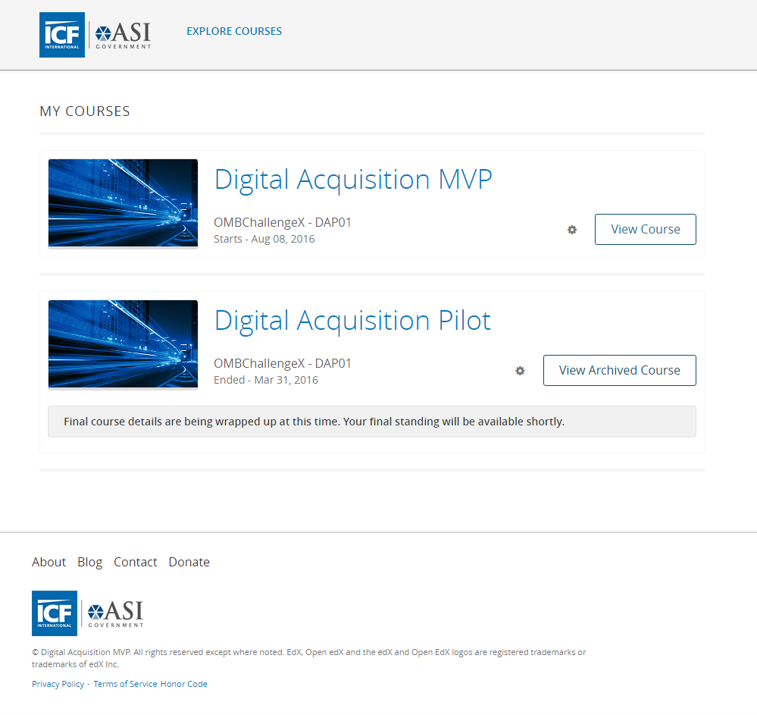
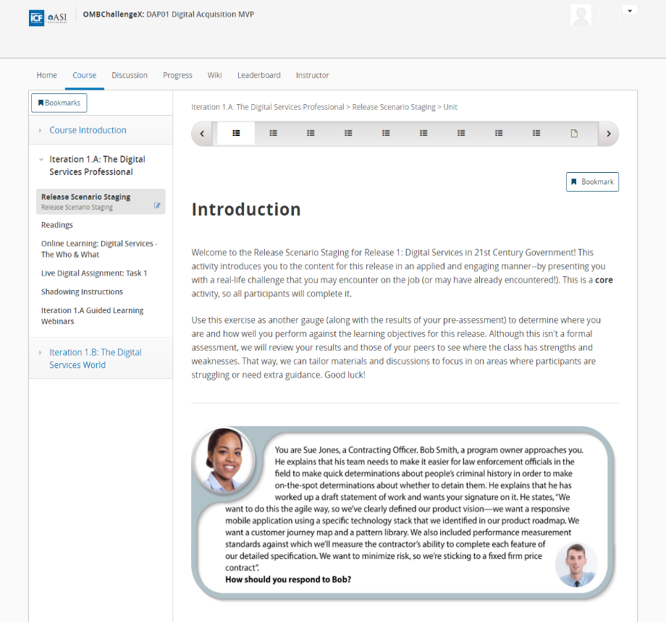
edX – Getting Started
Log in using your username and password
Program content is organized according to the 8 iterations
This is the course home page – your access point for all course information in an iteration

Slide 25

The Courseware Home Page
The Course Introduction section houses:
IDP
Orientation materials
Other important portal information
Left navigation is where content will display for each Iteration.
Tracking completion of content
Some content must be completed to unlock other pieces of content
Content will be marked, so you can pick out what is required/elective

Slide 26



Earning Badges
Two types of Badges
Olympic badges
Based on work completed in an iteration
Goes toward your participation grade
The number of CLPs you earn
Applied Skills badges
Based on activities performed outside of the program activities and content
Awarded by the type of activity performed
Different levels can be earned for engaging in an activity multiple times

Slide 27
Olympic Badging
- Complete all Iteration content marked with (B)
- Must complete 6 of 8 iterations for full Participant grade
- 60 CLPs upon completion of course
- Complete ½ of elective content, marked with (S&G)
- Earn 1 CLP for each badge
- Silver badge earned in all 8 Iterations: 10 CLPs upon completion of course
- Complete all of elective content, marked with (S&G)
- Earn 1 CLP for each badge
- Gold badge earned in all 8 Iterations: 10 CLPs upon completion of course
60
CLPs!
70
CLPs!
80
CLPs!

Slide 28
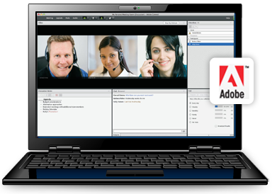
The Iteration Planning Meeting Webinar
What it is? | An introduction to the content, sessions, activities, and timing in each two-week iteration
Why it’s important? | It presents the iteration expectations and outcomes and provides a forum for questions
How to find it? | Follow the Adobe Connect link posted in the Course Info page of edX or respond to the meeting invite Begin August 8 and continue every other Monday
What’s the format? | Adobe Connect web conference
How long will it take? | 30 minutes

Slide 29

Release Scenario Staging
What it is? | A case study scenario that you review and answer questions about
Why it’s important? | It introduces you to the content and helps you to target development during the release (based on what you get right and wrong) It provides cohort-level information to facilitators
How to find it? | Release Scenario Staging link in the left navigation menu in the Courseware tab
What’s the format? | Case study scenario with questions
What’s the length? | 30 minutes

Slide 30
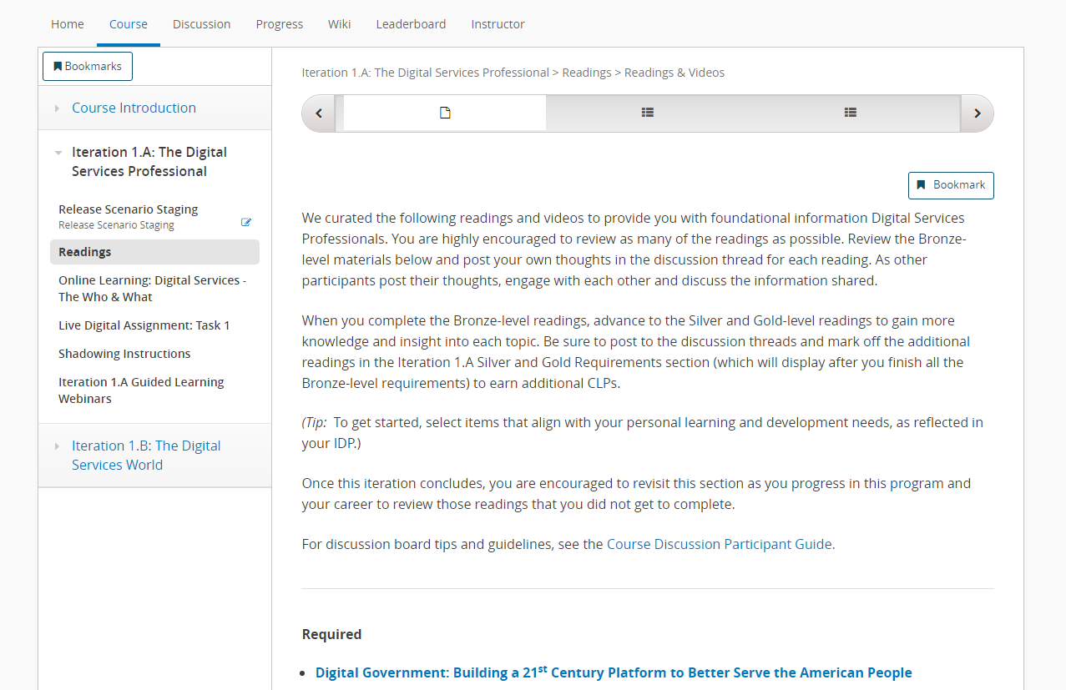
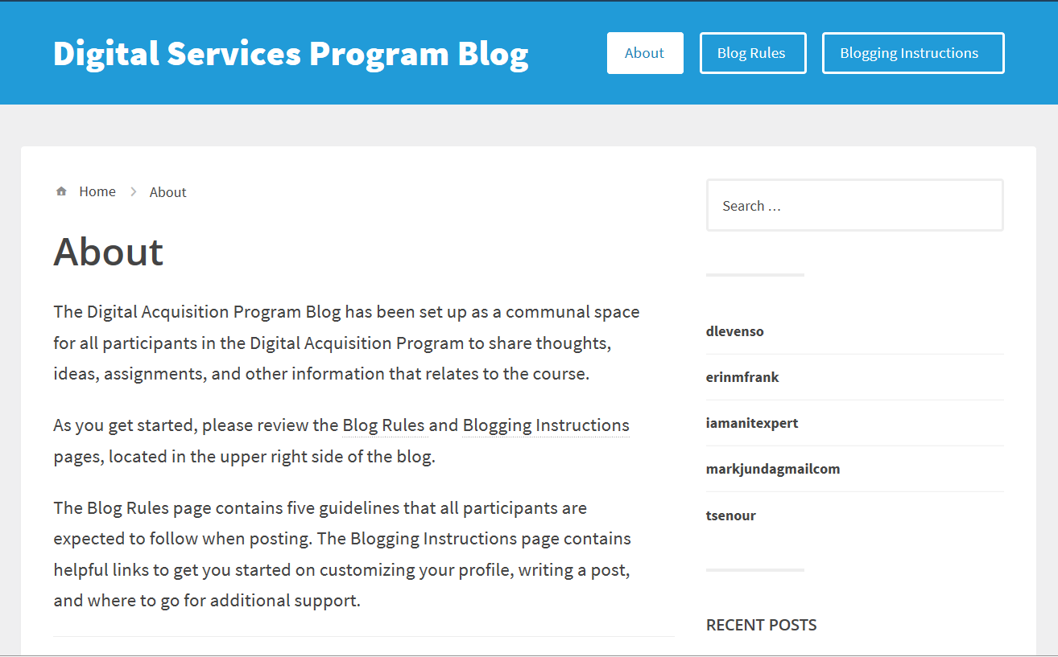
Self-Directed Learning – Reading Articles and Participating in Discussion Boards and Blog Posts
What it is? | Read articles and/or books that present foundational content and participate in discussion boards and blog posts to share your experiences and observations
Why it’s important? | It teaches you important content, provides future resources, and helps you to begin to synthesize and apply it to your situation
How to find it? | Under the title “Readings” in the left navigation of the iteration
What’s the format? | Articles, videos, podcasts, discussion boards, and blogs
How long will it take? | ~2 hours

Slide 31
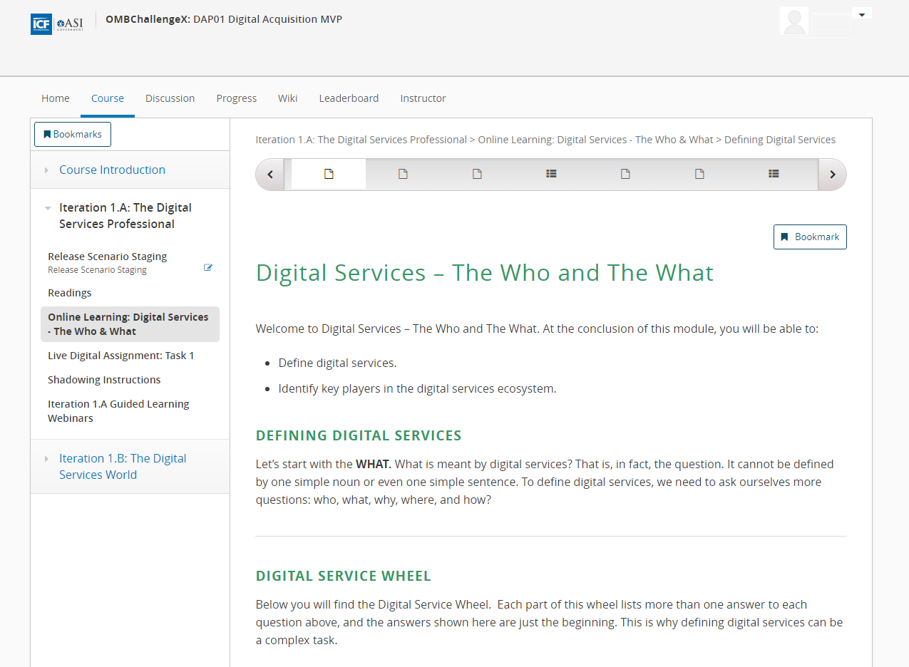
Self-Directed Learning - Online Learning
What it is? | Online learning content that delves into important topics and processes of the course
Why it’s important? | It teaches you key content, processes, and examples
How to find it? | Online Learning links in the left navigation menu of the Courseware tab
What’s the format? | Content is presented through text and images, videos, and knowledge checks
How long will it take? | ~60 minutes

Slide 32
Web Conferences
What it is? | An opportunity to address course content, function as an office hours session to answer questions or discuss additional information, function as a retrospective of what you learned, or hold a Demo Day for the Live Digital Assignments
Why it’s important? | Helps translate new knowledge into opportunities to practice Provides opportunities delve deeper into a topic or to reflect information you have gained Provides opportunities to present what is happening with your Live Digital Assignments and gain additional input or assistance
How to find it? | Follow the Adobe Connect link posted in the Course Info page of edX or respond to the meeting invite
What’s the format? | Adobe Connect webinar
What’s the length? | 60 minutes

Slide 33


Collaborative Classroom Session
What it is? | An opportunity for you to come together to dive into topics you haven’t tackled, practice what you’ve learned in a safe space, and reflect on the habits you’re developing
Why it’s important? | It provides a focused and longer time for you to engage in learning without distractions and to benefit from learning from each other
What’s the format? | Face-to-face classroom – come prepared to participate and do activities!
How long will it take? | 4 days
When are they? | Official dates will be posted on the Course Info page and emailed to all participants

Slide 34
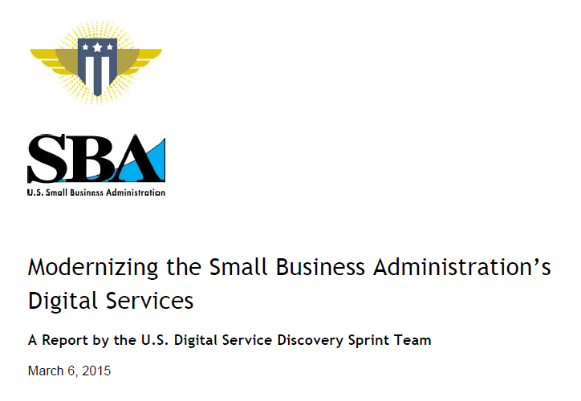
Opportunities for Apply What You’ve Learned: SBA Case Study and Threaded Scenario
What it is? | Activities and assignments to demonstrate knowledge transfer and innovation
Why it’s important? | It gets you to start practicing what you’re learning in a safe space and contributing to the field
How to find it? | In the left navigation menu of the Courseware tab, in classroom sessions, or shared via email
What’s the format? | Activity you complete or contribute your expertise to
How long will it take? | 60 minutes

Slide 35
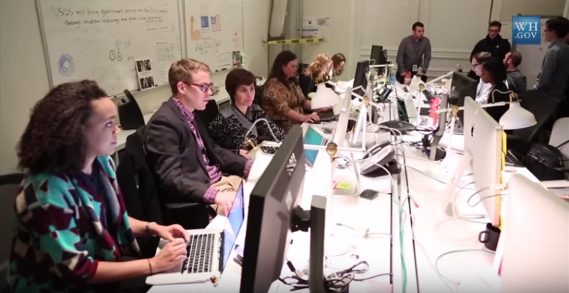
Opportunities for Apply What You’ve Learned: Acqu-a-thons
What it is? | Opportunity to observe digital services in action

Slide 36


Introduction to the Live Digital Assignment
What is it? | A group project throughout the program to take what you’ve learned and apply it to a real digital challenge faced by an agency
Why do it? | Build your teamwork skills Practice consultative, critical thinking, and problem solving skills Identify a relevant digital services challenge that could benefit from a digital services product, service, or tool
What do I have to do? | Put in the time and take it seriously Push your limits by thinking outside the box Connect with your group regularly

Slide 37


Shadowing
What it is? | An activity where you find an opportunity to shadow a digital services implementation/delivery team
Why it’s important? | Build your familiarity with modern design and development approaches Engage directly with digital services teams to learn about their work Build trust among acquisition professionals and customers across government and/or industry
How to find it? | Release 1 will have additional guidance and will help you select someone to shadow
What’s the format? | Shadow a product manager, developer, or anyone on a digital services delivery team within or outside of government.
How long will it take? | Two days (16 hours)

Slide 38
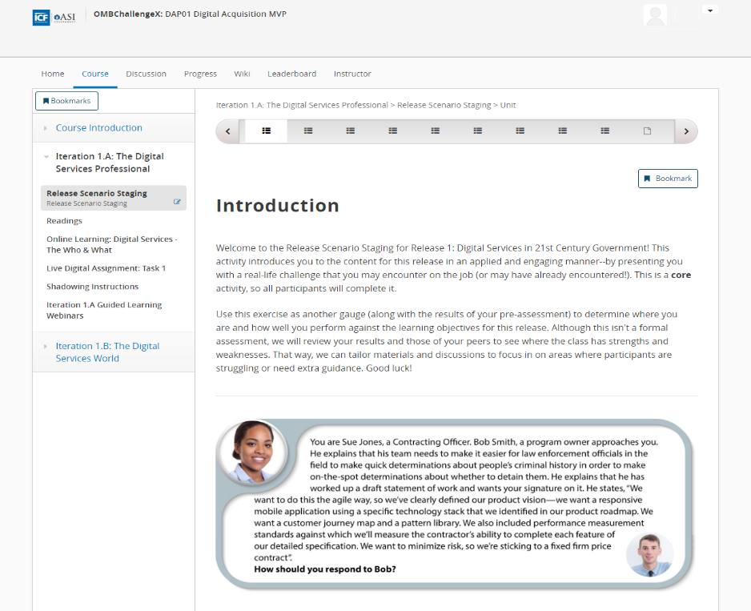
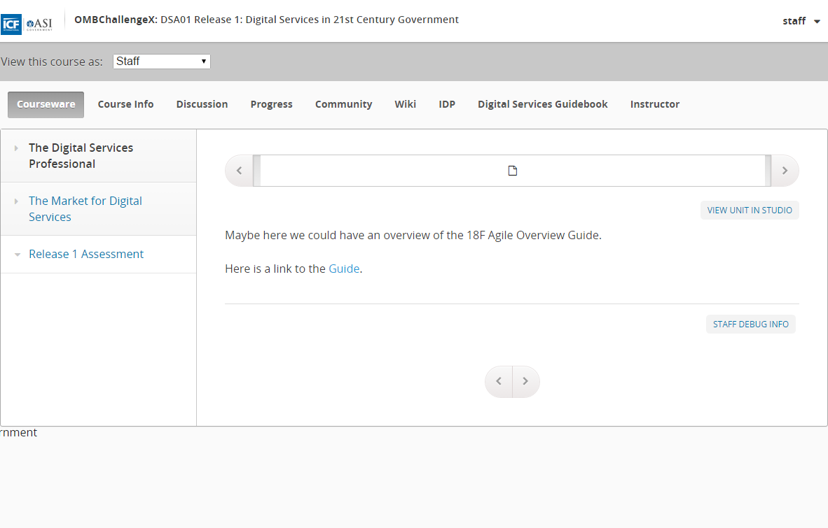
Assessment Opportunities
Program Pre-Assessment
Assess pre-program digital knowledge, skills, abilities
Release Scenario Staging
Self-assess knowledge, skills, abilities on a release
Release Assessment
Assess what was mastered/not mastered to refine the curriculum according to participants’ needs

Slide 39
Questions?
“Sometimes opportunities float right past your nose. Work hard, apply yourself, and be ready. When an opportunity comes, you can grab it.”
Julie Andrews

Slide 40
Lunch

Slide 41
Design Overview
Traci Walker, USDS & Dan Willis, DHS (or other Digital Service Expert)

Slide 42
DiSC Assessment Debrief

Slide 43
The Value of the DiSC Assessment
Self-awareness - according to Daniel Goleman who popularized the concept of emotional intelligence, self-awareness helps you to:
Understand where you are headed and why
Have a firm grasp of your capabilities and an understanding of when you need to ask for help from others
Make accurate judgment calls based on your assessment of your capabilities
Flex your style to align with what resonates with others you interact with
Build team norms by understanding each other’s styles and tendencies and how that impacts your interaction as a team as you begin to work on the live digital assignment
You will have the opportunity to discuss your styles and tendencies when you are assigned your live digital assignment team later this afternoon

Slide 44
Introduction to the DiSC Assessment
DiSC measures:
Your response to problems and challenges – the D
How you influence others to your point of view – the i
Your response to the pace of the environment – the S
Your reaction to rules and procedures- the C
DiSC helps you:
Reflect on the strengths and weaknesses of your individual style
Identify how your strengths and weaknesses impact your communication and interaction with others on your team
Consider what others’ styles might be and how that impacts how you work and interact with them
D
i
C
S

Slide 45
Activity: Plan a Meeting

Slide 46
Plan a Meeting Activity Instructions
Get into assigned groups
Your assignment: you find out that your manager will be out of the office and she has asked you to plan a meeting including determining the agenda and who will lead it
Read the scenario instructions in your Participant Packet and work in groups to plan the meeting
Be prepared to share your plan with the full group

Slide 47
Debrief – What Did You Learn?
Compare the plans that each team presented
What were some of the similarities across the different groups?
What were some of the differences across groups?
What did you notice about working with your group? What worked well? What were the challenges?
Take a few minutes to debrief with a learning peer
How did you interact with your team during this exercise (e.g., led the team, argued with others about the best approach)?
What did your interaction teach you about how to work with different behavioral styles?

Slide 48







The Two DiSC Perceptions
DiSC examines:
Environments as either favorable or unfavorable
Self as either more or less powerful than the environment
Environment
Self
Favorable – see fun in a situation, challenge as opportunity to triumph
Unfavorable – challenges and obstacles as barriers
Self as more powerful than the environment
Self as less powerful than the environment

Slide 49

The Four Dimensions of DiSC
(D)ominance
How to approach problems
(i)Nfluence
How to approach people
More Powerful
Unfavorable
Favorable
(S)teadiness
How to approach the pace of the environment
(C)onscientiousness
How to approach procedures and rules
Less Powerful

Slide 50
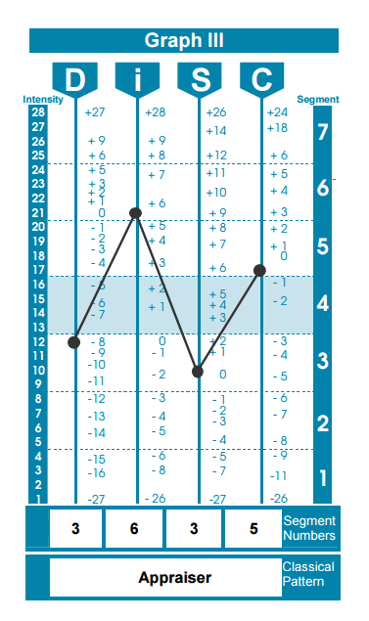
DiSC Assessment Report Review: Stage I – Your DiSC Graph
Page 3 shows your scores on each of the DiSC dimensions based on your responses
Shows your highest dimension/s (D, i, S, C) and classical profile pattern
Describes your style and preferences and how they show up at work

Slide 51
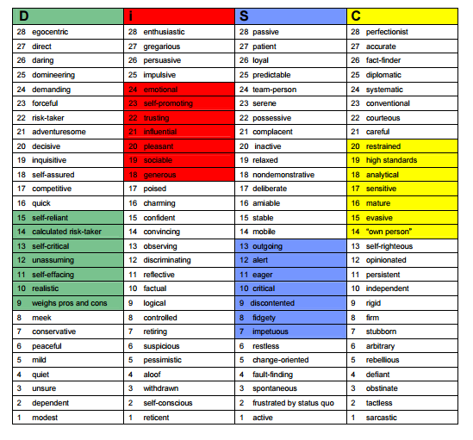
DiSC Assessment Report Review: Stage II – Your Intensity Index
Review the highlighted words – adjectives that describe your High, Medium, and Low behavior
Review the definitions on the next pages to become more aware of your strengths and weaknesses
*Remember that any overused strength can also be a weakness

Slide 52
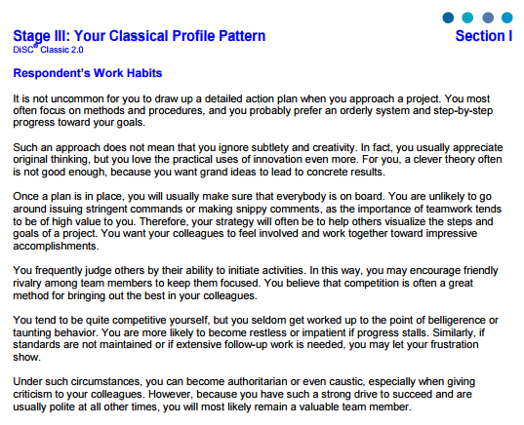
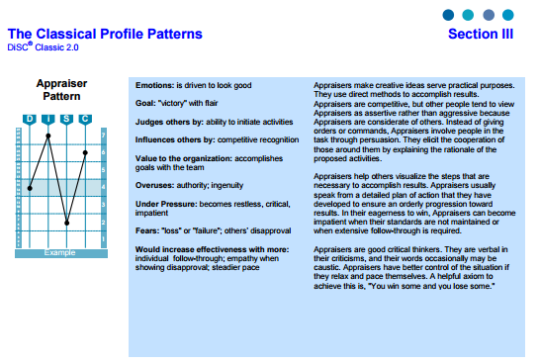
DiSC Assessment Report Review: Stage III – Your Classical Profile Pattern
Combines your four dimensions into one of 15 unique patterns
Provides expectations
Take a few minutes to review your:
Motivations
Work habits
Insights (or potential blind spots)

Slide 53

Dominance
Value to the Team
Gets immediate results
Forward-looking
Challenge-oriented
Initiates activity
Innovative
Possible Limitations
Overuse of position
Set standards too high
Lack tact and diplomacy
Take on too much too quickly
Lack of concern for others
Need of the High “D”
Control

Slide 54

Influence
Value to the Team
Optimism and enthusiasm
Creative problem solving
Motivates others to goals
Team player
Negotiates conflicts
Possible Limitations
Inattentive to details
Be unrealistic in appraisals
Trust people indiscriminately
Situational listener
Disorganized/lacks follow through
Need of the High “i”
Recognition

Slide 55

Steadiness
Value to the Team
Dependable team player
Work for leader and a cause
Patient and empathetic
Logical step-wise
Service-oriented
Possible Limitations
Yield to avoid controversy
Difficulty in establishing priorities
Dislike of unwarranted change
Difficulty dealing with diverse situations
Need of the High “S”
Acceptance

Slide 56

Conscientiousness
Value to the Team
Maintains high standards
Conscientious and steady
Defines, clarifies, gets information and tests
Objective – “the anchor of reality”
Possible Limitations
Be defensive when criticized
Get bogged down in details
Be overly intense for the situation
Appear somewhat aloof and cool
Need of the High “C”
Safety

Slide 57
Interacting With Other Styles - Tactics
Be aware
Reflect on your own style – What are your strengths and weaknesses? How might someone with a different style respond to your approach?
Consider what you know about the other’s style and adapt where appropriate
Ask questions –
Ask open-ended questions to uncover someone else’s position, potential contribution, process, and emotions if they are not forthcoming with them
Partner to generate solutions together
Don’t take it to heart –
Sometimes it’s not a critique of you or how you approach a challenge, it’s a function of a different style and approach
Provide support –
Build in opportunities to support the style’s ideal environment/conditions, where possible

Slide 58
Reflect – What Does This Mean for You?
Individually reflect on what you learned about styles and preferences and how you will use this knowledge in your Participant Packet
What did you learn about your style?
What did you learn about how you best interact with others? What are some situations where you would thrive vs. struggle?
What are some situations where your style and that of another individual’s may be in conflict (in general)?
Share your reflections with a partner in the classroom

Slide 59
Afternoon Break

Slide 60
Live Digital Assignment

Slide 61
Purpose and Outcome
Purpose
Hone your teamwork skills by working in groups
Practice consultative, critical thinking, and problem solving skills in alignment with the overall program goals
Identify a relevant digital services challenge that could benefit from a digital services product, service, or tool
Outcome
Final briefing
Case study
Artifact/deliverable

Slide 62
Evaluation Criteria
Peer Rating
Engaged Contribution
Collaborative Action
Program Leadership Rating following Shark Tank Pitch
Technical Communication
Analytical Ability

Slide 63
What’s Next?
Section of Program | Task Overview | Deliverables | Deadline | Time Commitment
Orientation | Select a “real life” digital services challenge Use the Design process to draft a hypothesis to solve the challenge Submit proposed project & hypothesis to your assigned USDS coach. You will collaborate with them to ensure it is achievable. | Submit project idea and draft hypothesis by the end of Day 3. Your USDS assignment guide will provide feedback. | Draft hypothesis: Thursday, Aug. 4 Final hypothesis: Friday, Aug. 12 | 3-4 hours
Iteration 1.A | Create a plan for how your team plans to execute and test your approved hypothesis. Describe how you plan to use agile principles to execute your plan. Work with your USDS guide and program faculty during office hours to refine your plan. | Create a draft plan for submission. Your USDS assignment guide will provide feedback. Finalize your plan. | Draft plan: Thursday, Aug. 18 Final plan: Thursday, Sept. 1 | 4-6 hours
Iteration 1.B | Create a product vision Set up systems or other collaboration tools that will allow you to execute your plan. Share your hypothesis and product vision as part of a Demo Day. | Create a draft product vision for submission. Your USDS assignment guide will provide feedback. Finalize your product vision. | Draft product vision: 09/09/16 Final product vision: 10/06/16 | 4 hours

Slide 64
Live Digital Assignment Activity
Team Norms
Share your DiSC Style with the group
What do you think you can contribute to the group, based on your DiSC style
Brainstorming Activity
Write a list of your biggest acquisition challenges
Select your top 5
Over the next two days, anticipate that:
Your challenges will be really big, and you will need to work on targeting something that can be realistically addressed.
Your challenges may be different from what you originally brainstormed, because what you will learn in the next few days will change what you perceive the challenge to be.

Slide 65
Preview of Tomorrow

Slide 66
Day 2 Agenda
Day 2 – Digital Services and Agile
Morning | Digital Services Playbook Digital Services Overview
LUNCH
Afternoon | Agile Overview Scrum Framework Release Planning Sprint Planning, Implementation, Review, and Retrospective
Expectations
Location: Indicate training location here
Come prepared for a full day of activities and interaction

Slide 67
Networking Happy Hour!

